Slide 1
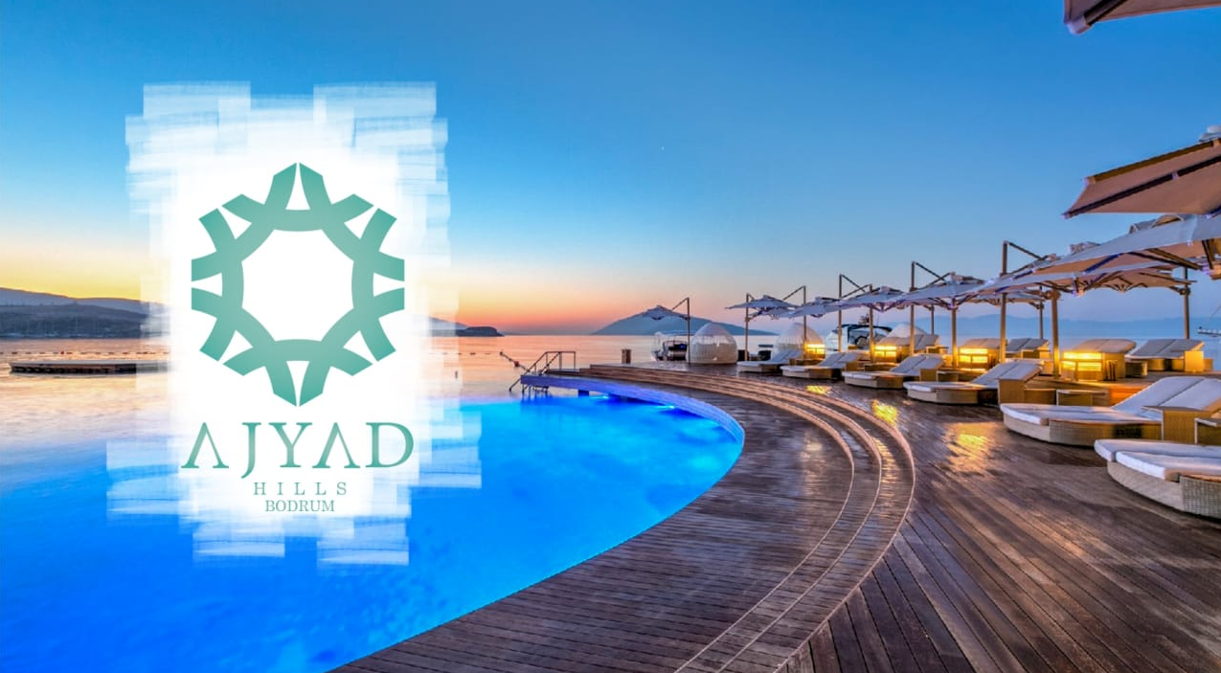

Slide 2
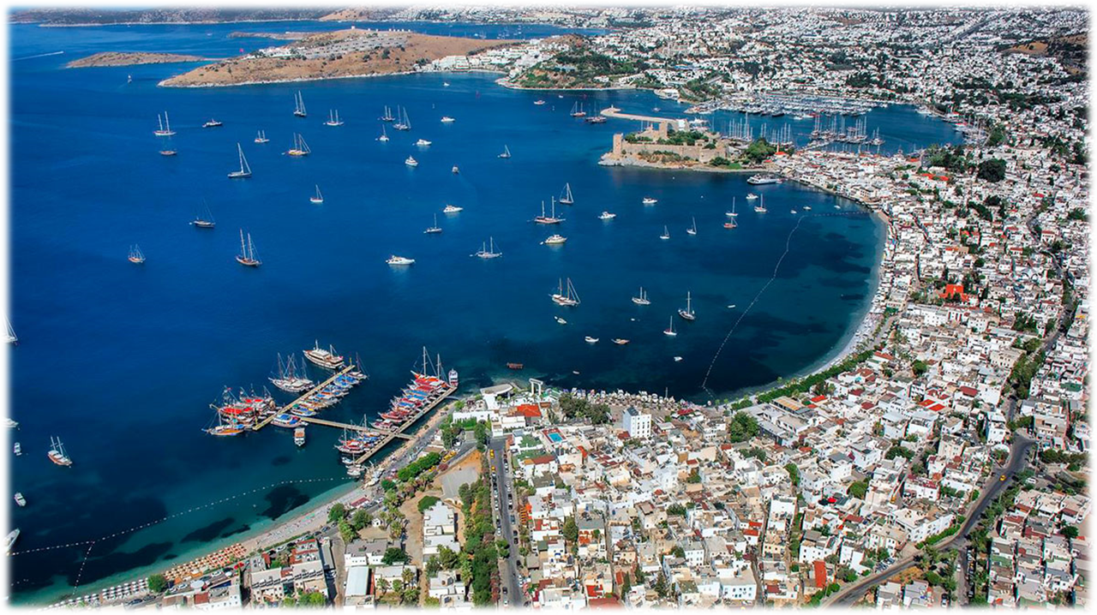
AJYAD HILLS BODRUM

Slide 3
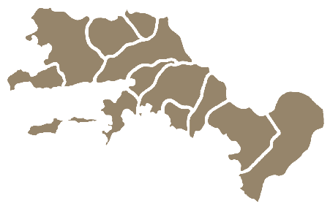

Land Area
Muğla City Center
30 km
Yatağan City Center
10 km

Slide 4
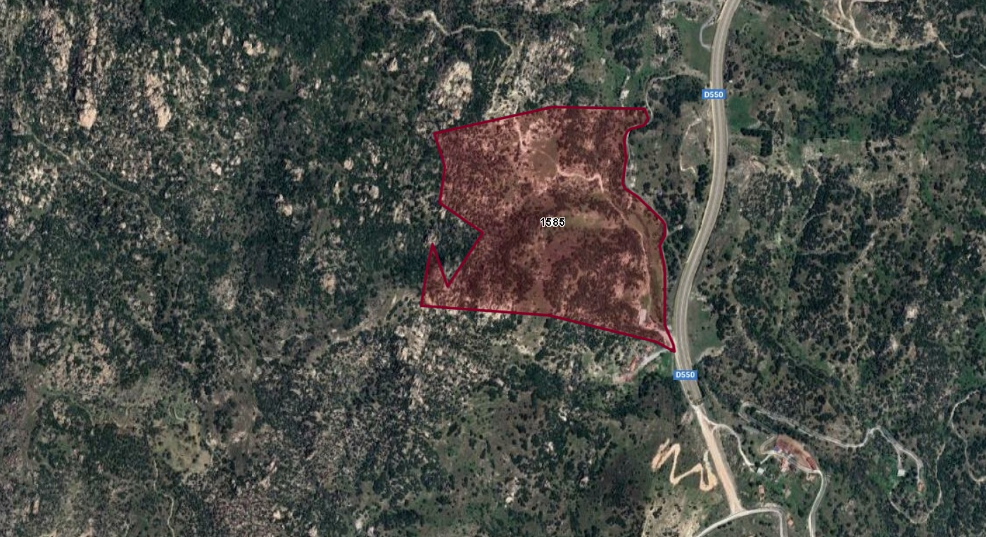

Land Area
189,867,11
Parcel : 0/1585

Slide 5
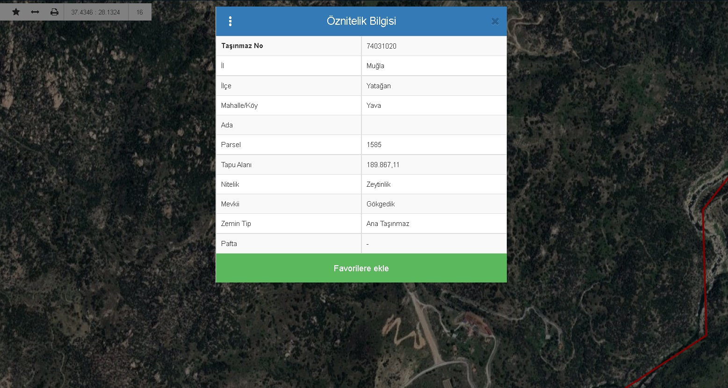

Slide 6
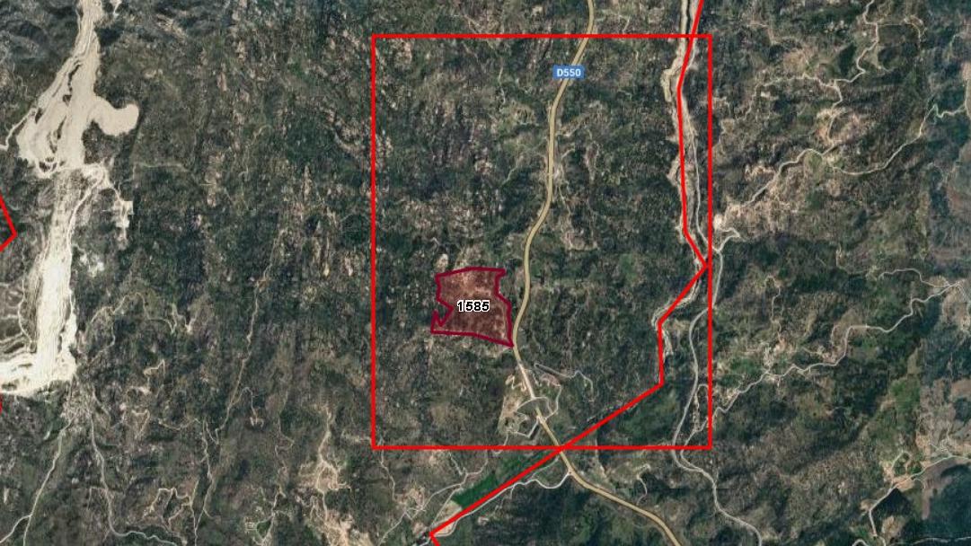
189,867,11 land area,Electricity Available,Water Available,1000 olive trees,3+1 house,Barn Available,500-cattle farm can be built
land area : 189,867,11 Sqm
Electricity: Available
Water: Available
Barn: Available
Road: Available
Olive Trees: 2500 tree
house: 3+1
Land Price: €1,200,000

Slide 7
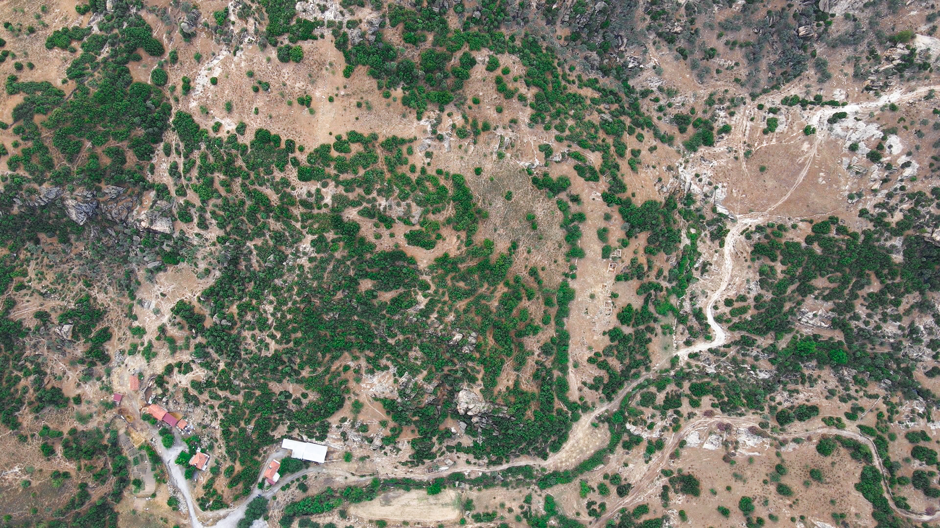

Slide 8
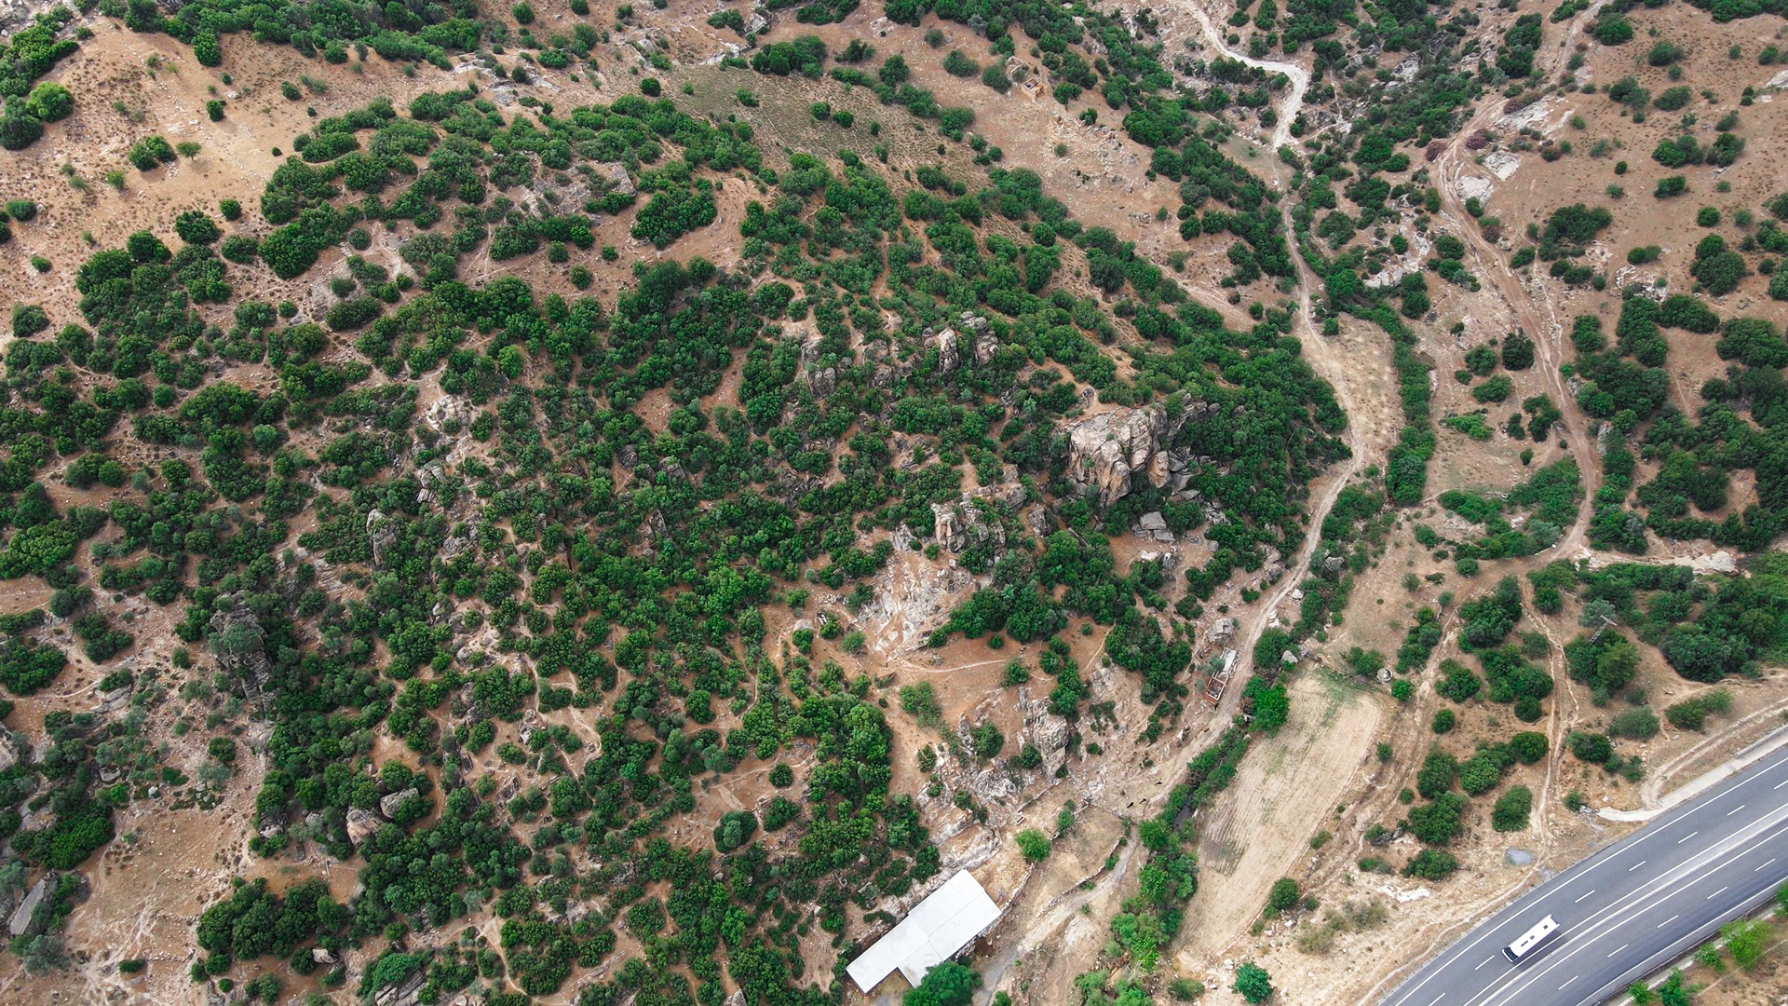
Land’s Photos
2
+

Slide 9
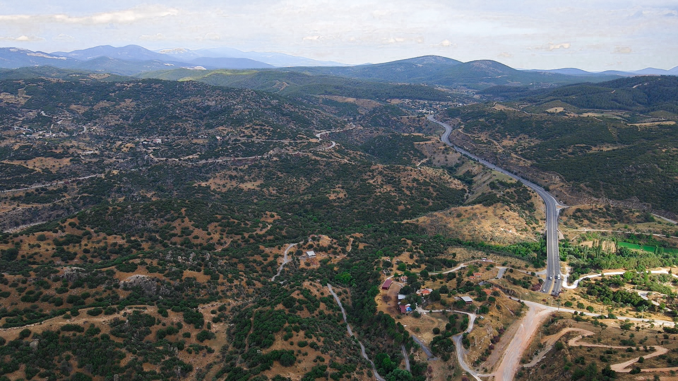
Land’s Photos
2
+

Slide 10
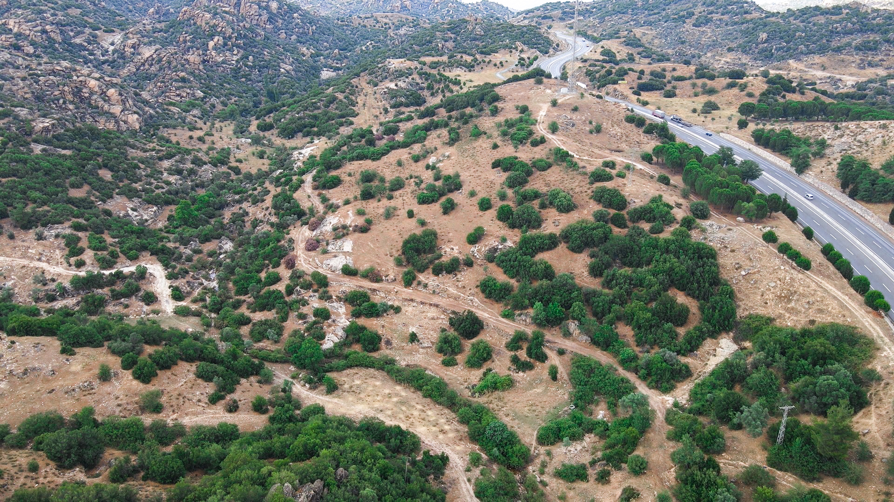
Land’s Photos
2
+

Slide 11
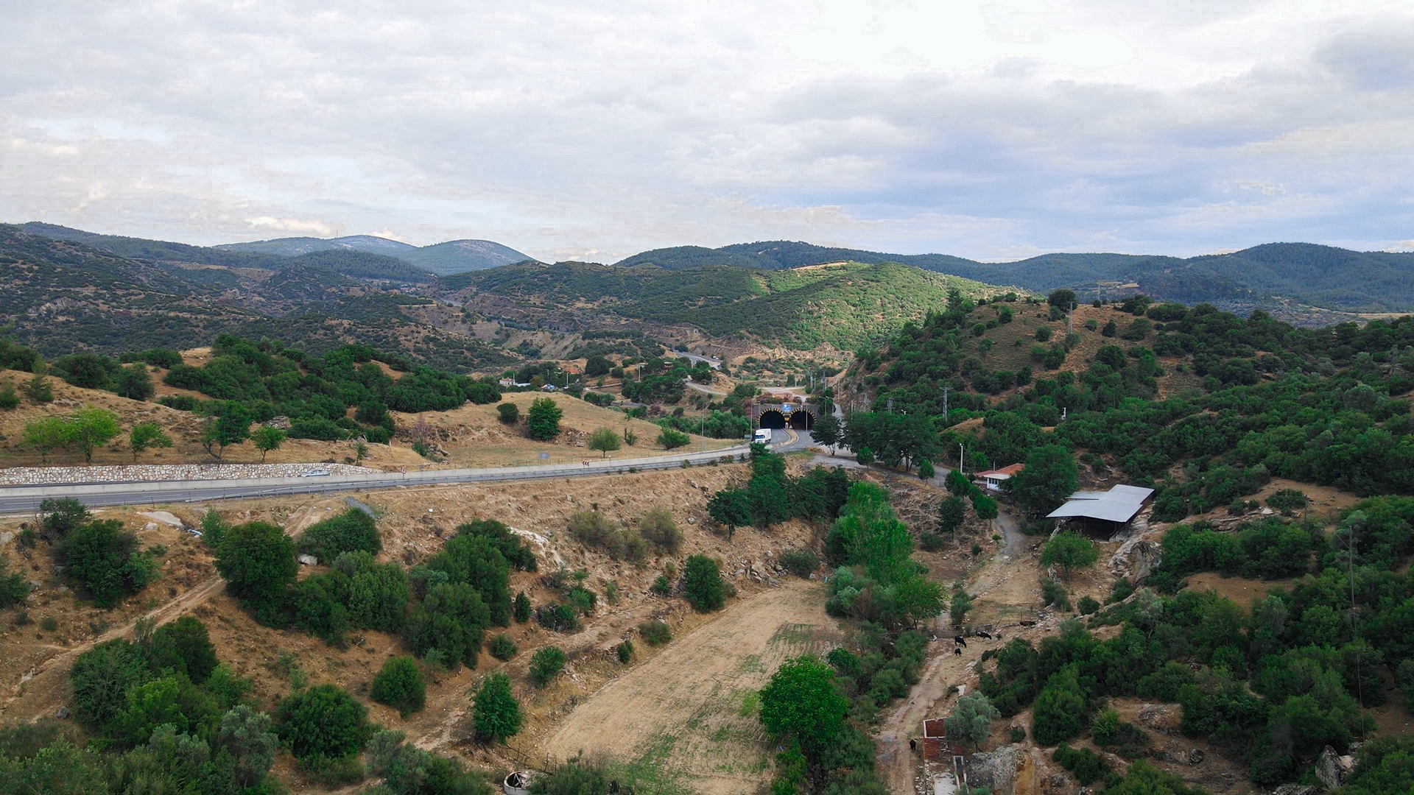
Land’s Photos
2
+

Slide 12
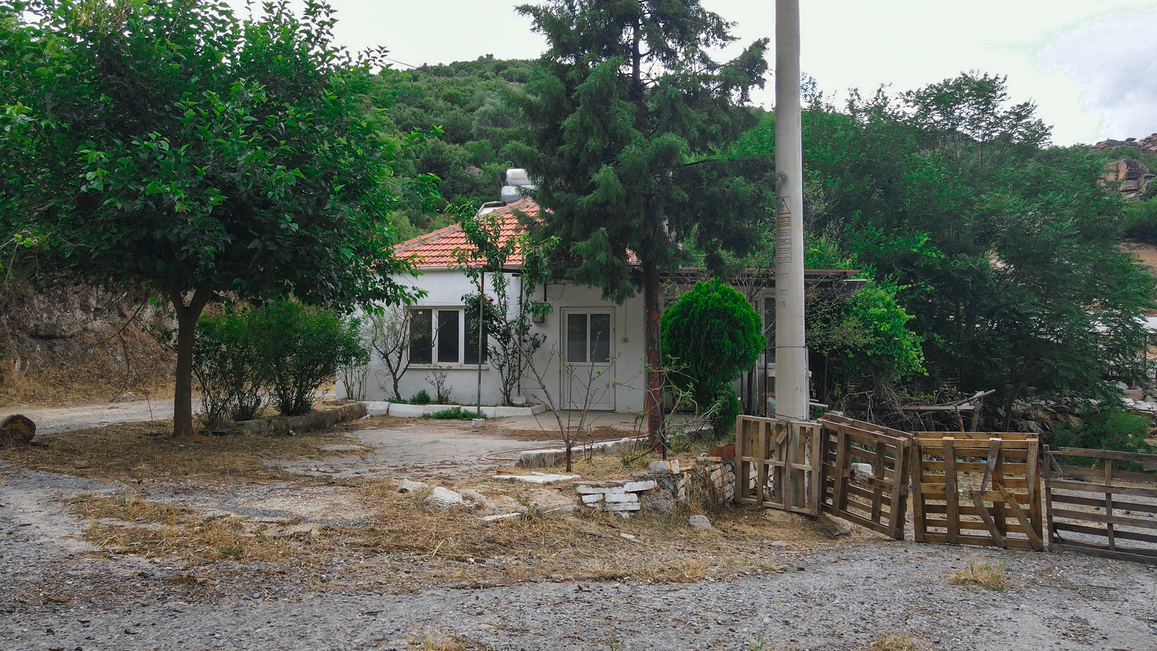
Land’s Photos
2
+

Slide 13
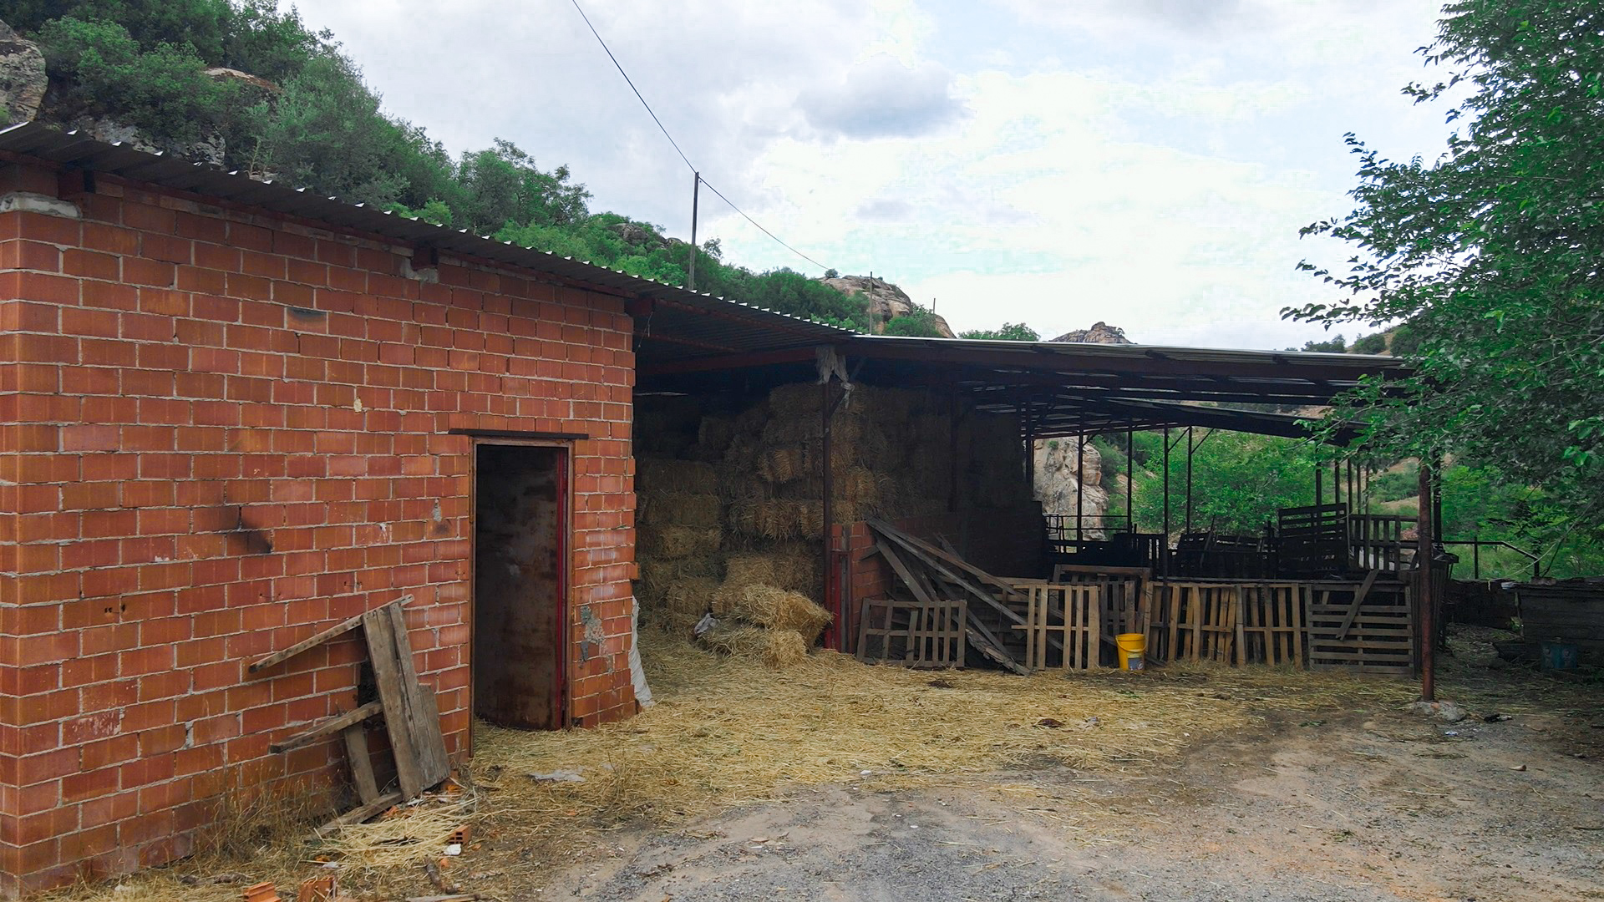
Land’s Photos
2
+

Slide 14
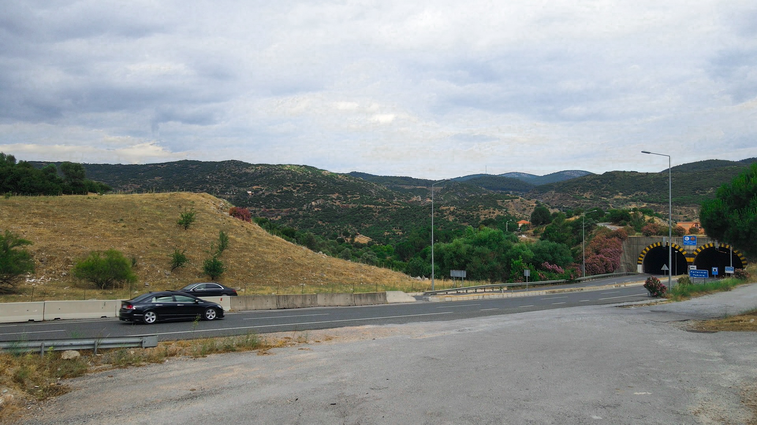
Land’s Photos
2
+

Slide 15
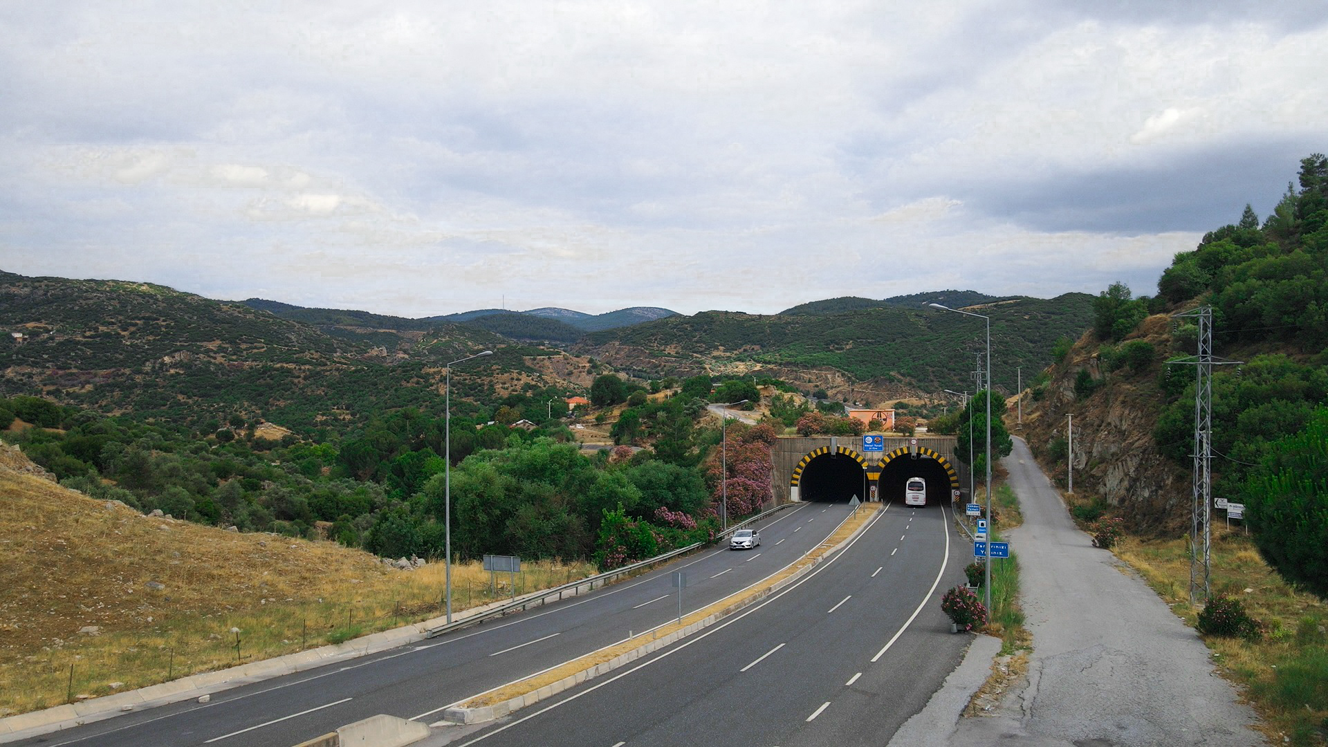
Land’s Photos
2
+

Slide 16
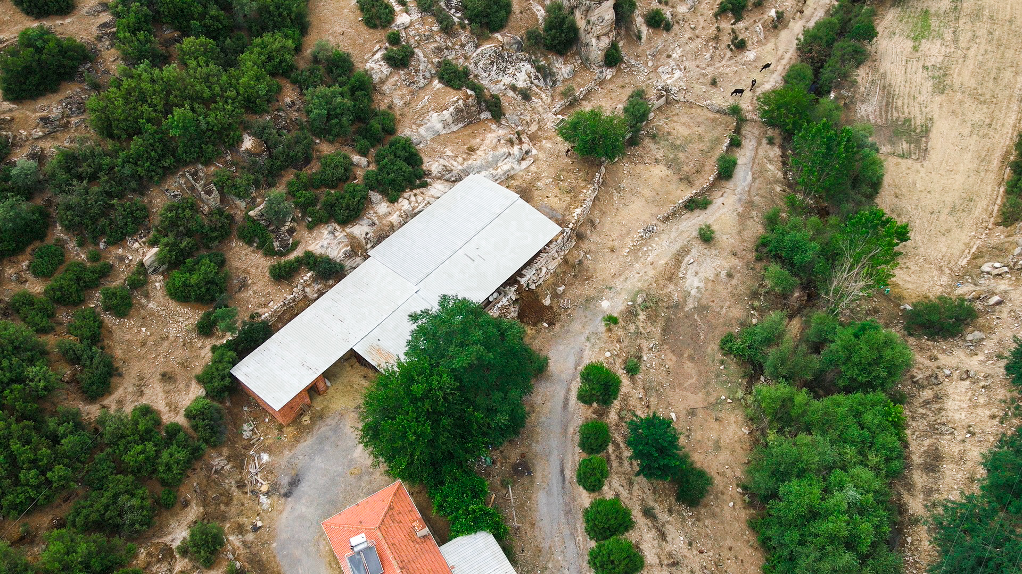
Land’s Photos
2
+

Slide 17
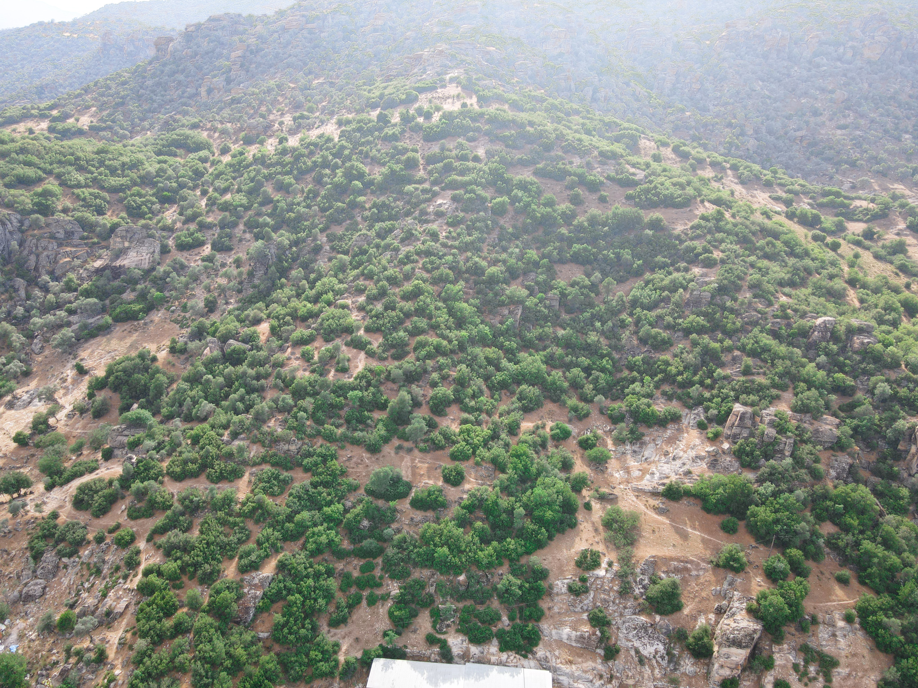
Land’s Photos
2
+

Slide 18
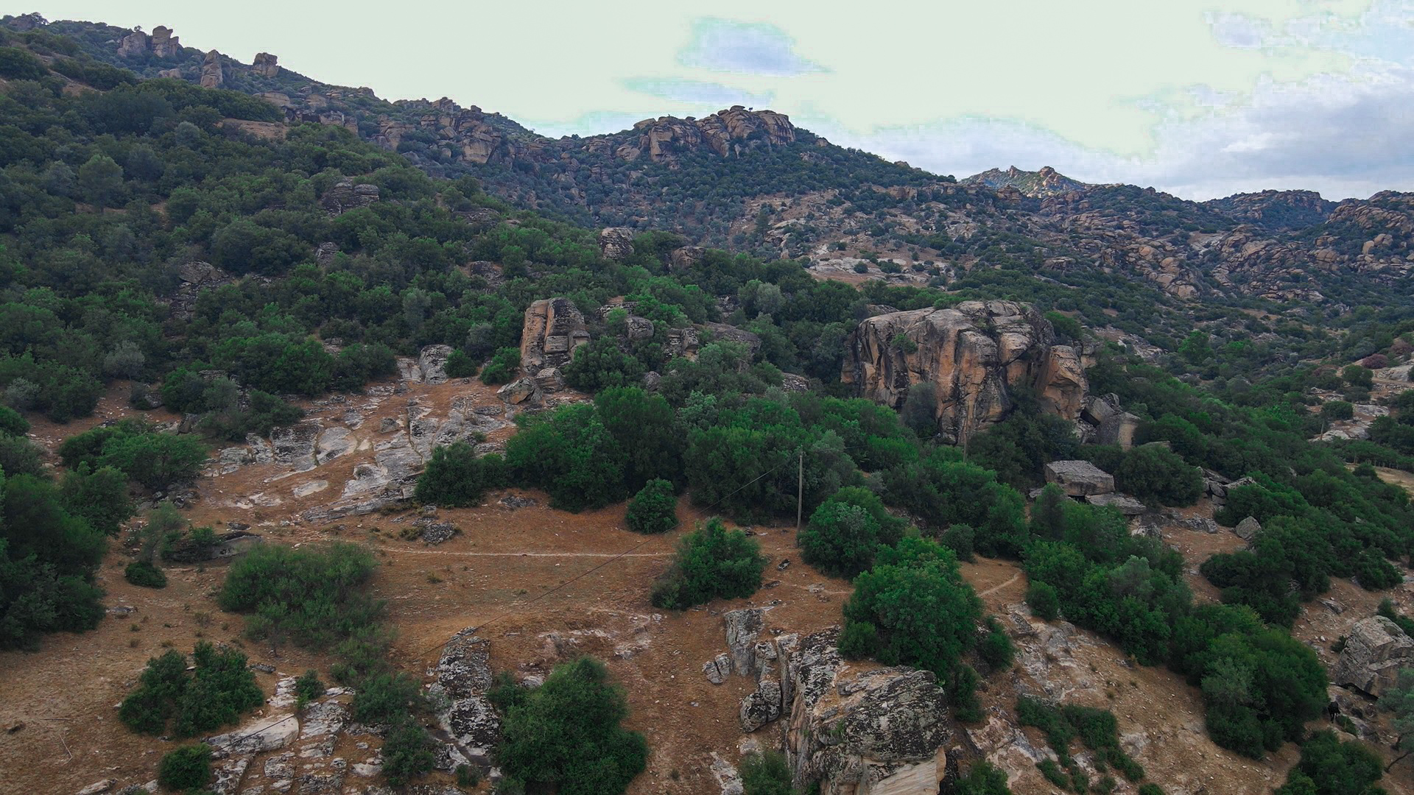
Land’s Photos
2
+

Slide 19

B O D R U M :
K o n a c k M a h . M i t h a t P a s a S k .
N o : 3 K a p i N 0 : 1 , B o d r u m / M u g l a
I S T A N B U L :
H a r b i y e M a h . A b d i İ p e k ç i C a d .
N o : 4 9 / 1 0 N i ş a n t a ş ı , Ş i ş l i / İ s t a n b u l
T e l : + 9 0 2 1 2 2 2 5 3 2 2 3
M o b : + 9 0 5 4 2 2 2 0 5 2 2 2
w w w . a j y a d i n v e s t m e n t . c o m

